Slide 1
CompTIA Security+ Guide to Network Security Fundamentals, Sixth Edition
Chapter 14
Business Continuity

Slide 2
Objectives
14.1 Define business continuity
14.2 Describe how to achieve fault tolerance through redundancy
14.3 Explain different environmental controls
14.4 Describe forensics and incident response procedures

Slide 3
What is Business Continuity?
Business Continuity
An organization’s ability to maintain operations after a disruptive event
Business continuity preparedness involves:
Business continuity planning
Business impact analysis
Disaster recovery planning

Slide 4
Business Continuity Planning (B C P)
B C P is the process of:
Identifying exposure to threats
Creating preventative and recovery procedures
Testing them to determine if they are sufficient
B C P consists of three essential elements:
Business recovery planning
Crisis management and communications
Disaster recovery

Slide 5
Business Impact Analysis (B I A) (1 of 2)
B I A - identifies business functions and quantifies the impact a loss of these functions may have on business operations
These range from:
Impact on property (tangible assets)
Impact on finance (monetary funding)
Impact on safety (physical protection)
Impact on reputation (status)
Impact on life (well-being)
A B I A will help determine the mission-essential function
Activity that serves as the core purpose of the enterprise

Slide 6
Business Impact Analysis (B I A) (2 of 2)
A B I A can also help in the identification of critical system
That support the mission-essential function
Identifying a single-point-of-failure (SPOF)
Which is a component or entity in a system which will disable the entire system, should it no longer function
Minimizing these single failure points results in high availability
Many B I A s also contain a privacy impact assessment
Used to identify and mitigate privacy risks
Privacy threshold assessment
Can determine if a system contains personally identifiable information (P I I)

Slide 7
Disaster Recovery Plan (D R P) (1 of 5)
Disaster recovery plan (D R P)
Focuses on protecting and restoring information technology functions
Written document detailing process for restoring I T resources:
Following a disruptive event
Comprehensive in scope
Intended to be a detailed document that is updated regularly
Most D R P s:
Have a common set of features
Cover specific topics
Require testing for verification

Slide 8
Disaster Recovery Plan (D R P) (2 of 5)
Features
Typical outline of a D R P:
Unit 1: Purpose and Scope
Unit 2: Recovery Team
Unit 3: Preparing for a Disaster
Unit 4: Emergency Procedures
Unit 5: Restoration Procedures

Slide 9
Disaster Recovery Plan (D R P) (3 of 5)
Topics
Sequence in restoring systems (order of restoration)
Which systems should have priority and be restored before other systems?
What should be done if a disaster makes the current location for processing data no longer available
An alternative processing site must be identified
Failback – the process of resynchronizing data back to the primary location

Slide 10
Disaster Recovery Plan (D R P) (4 of 5)
Testing
Disaster exercises are designed to test the effectiveness of the D R P
Disaster exercise objectives
Test efficiency of interdepartmental planning and coordination in managing a disaster
Test current D R P procedures
Determine response strengths and weaknesses
Tabletop exercises
Simulate an emergency situation but in an informal and stress-free environment
An after-action report should be generated
To analyze the exercise results to identify strengths to be maintained and weaknesses to improve upon

Slide 11
Disaster Recovery Plan (D R P) (5 of 5)
Feature | Description
Participants | Individuals on a decision-making level
Focus | Training and familiarizing roles, procedures, and responsibilities
Setting | Informal
Format | Discussion guided by a facilitator
Purpose | Identify and solve problems as a group
Commitment | Only moderate amount of time, cost, and resources
Advantage | Can acquaint key personnel with emergency responsibilities, procedures, and other members
Disadvantage | Lack of realism; does not provide a true test

Slide 12
Fault Tolerance Through Redundancy
Fault tolerance
Refers to a system’s ability to deal with malfunctions
The solution to fault tolerance is to build in redundancy
Which is the use of duplicated equipment to improve the availability of a system
A goal is to reduce a variable known as the mean time to recovery (M T T R)
The average amount of time that it will take a device to recover from a failure that is not a terminal failure
Redundancy planning
Applies to servers, storage, networks, power, sites, and data

Slide 13
Servers (1 of 3)
Servers
Play a key role in network infrastructure
Failure can have significant business impact
Clustering
Combining two or more devices to appear as a single unit
Server cluster
Multiple servers that appear as a single server
Connected through public and private cluster connections
Types of server clusters
Asymmetric
Symmetric

Slide 14
Servers (2 of 3)
In an asymmetric server cluster, a standby server performs no function except to be ready if needed
Used for databases, messaging systems, file and print services
All servers do useful work in a symmetric server cluster
If one server fails, remaining servers take on failed server’s work
More cost effective than asymmetric clusters
Used for Web, media, and V P N servers

Slide 15
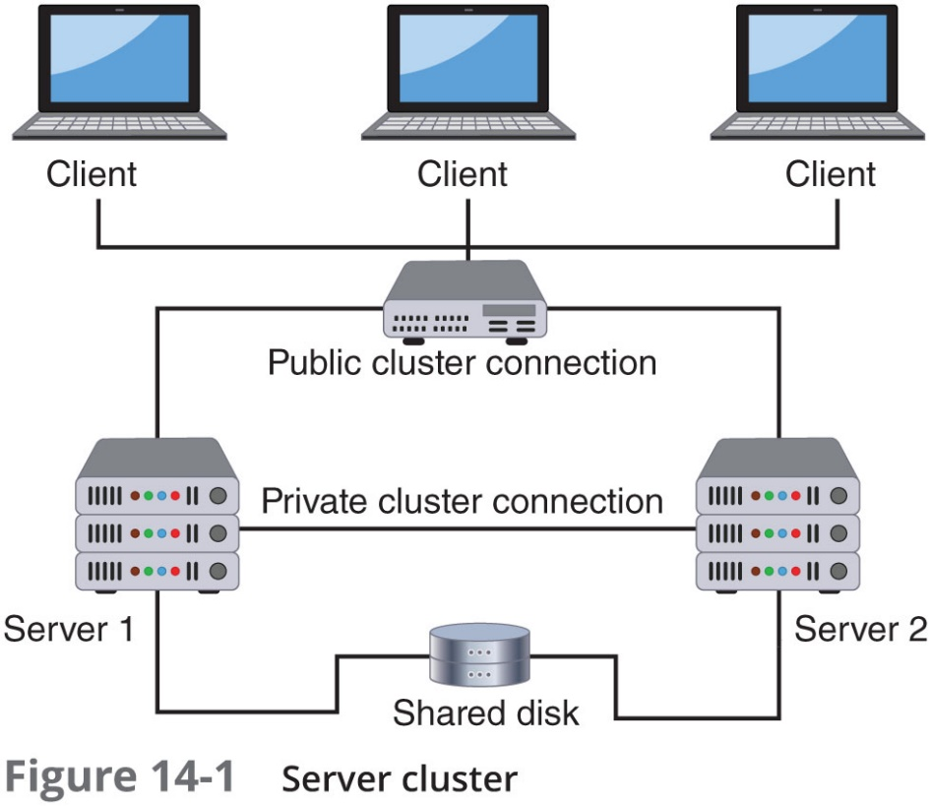
Servers (3 of 3)

Slide 16
Storage (1 of 6)
Storage - a trend in data storage is to use solid-state drives (S S Ds)
S S Ds are more resistant to failure and are considered more reliable than traditional H D Ds
H D D s are often the first components to fail
Some organizations keep spare hard drives on hand
Mean time between failures (M T B F)
Measures average time until a component fails and must be replaced
Can be used to determine number of spare hard drives an organization should keep

Slide 17
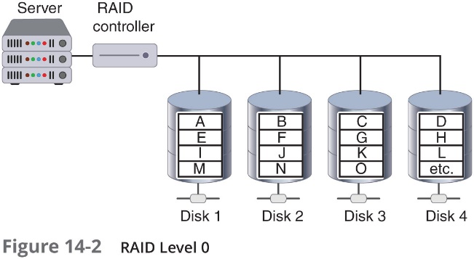
Storage (2 of 6)
Redundant Array of Independent Devices (R A I D)
Uses multiple hard disk drives to increase reliability and performance
Can be implemented through software or hardware
Several levels of R A I D exist
R A I D Level 0 (striped disk array without fault tolerance)
Striping partitions hard drive into smaller sections
Data written to the stripes is alternated across the drives
If one drive fails, all data on that drive is lost

Slide 18
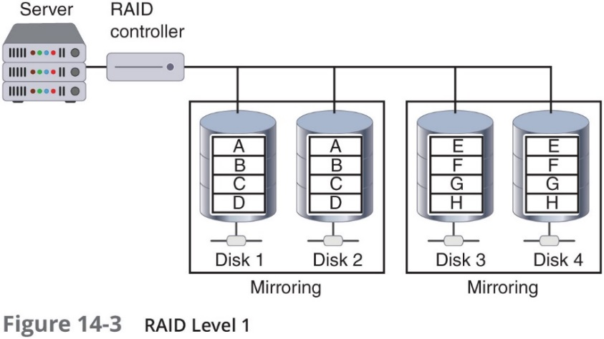
Storage (3 of 6)
RAID Level 1 (mirroring)
Disk mirroring used to connect multiple drives to the same disk controller card
Action on primary drive is duplicated on other drive
Primary drive can fail and data will not be lost
Disk duplexing
Variation of RAID Level 1
Separate cards used for each disk
Protects against controller card failures

Slide 19
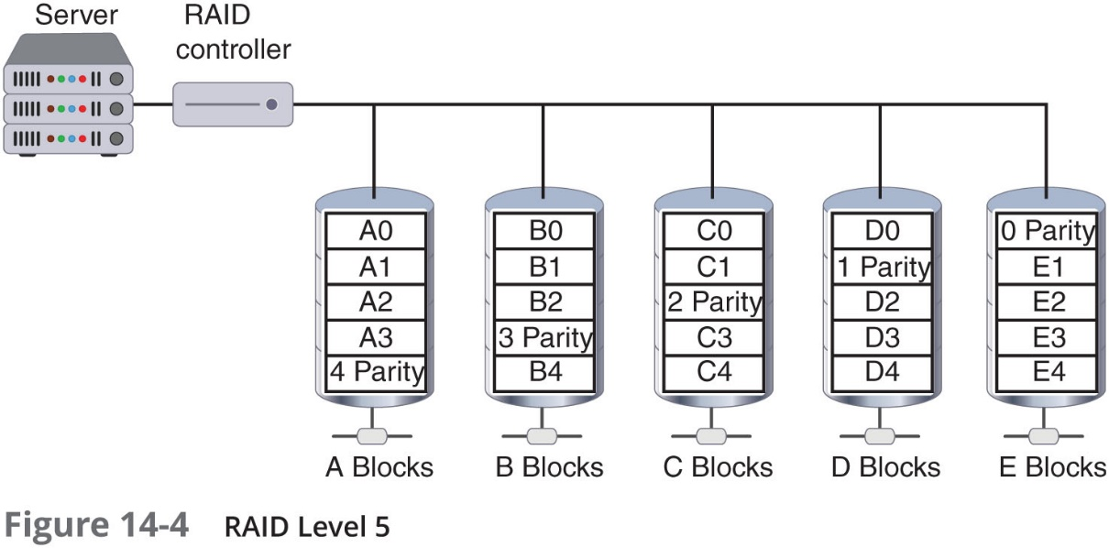
Storage (4 of 6)
RAID Level 5 (independent disks with distributed parity)
Distributes parity (error checking) across all drives
Data stored on one drive and its parity information stored on another drive

Slide 20
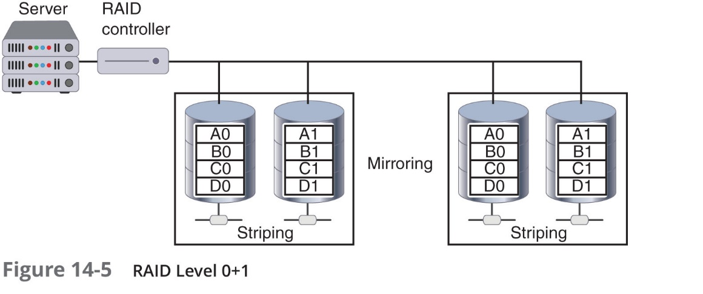
Storage (5 of 6)
RAID 0+1 (high data transfer)
Nested-level R A I D
Mirrored array whose segments are RAID 0 arrays
Can achieve high data transfer rates

Slide 21
Storage (6 of 6)
RAID level | Description | Min number of drives needed | Typical application | Advantages | Disadvantages
RAID 0 | Uses a striped disk array so that data is broken down into block and each block is written to a separate disk drive | 2 | Video production and editing | Simple design, easy to implement | Not fault-tolerant
RAID 1 | Data written twice to separate drives | 2 | Financial | Simplest RAID to implement | Can slow down system if RAID controlling software is used instead of hardware
RAID 5 | Each data block is written on a data disk and parity for blocks in the same rank is generated and recorded on a separate disk | 3 | Database | Most versatile RAID | Can be difficult to rebuild if a disk fails
RAID 0+1 | A mirrored array with segments that are RAID 0 arrays | 4 | Imaging applications | High input/output rates | Expensive

Slide 22
Networks
Redundant networks
May be necessary due to critical nature of connectivity today
Wait in the background during normal operations
Use a replication scheme to keep live network information current
Launch automatically in the event of a disaster
Hardware components are duplicated
Some organizations contract with a second Internet service provider as a backup
Software defined networks (S D N s)
S D N controller can increase network reliability and may lessen the need for redundant equipment

Slide 23
Power (1 of 2)
Maintaining power is essential when planning for redundancy
Uninterruptible power supply (U P S)
Maintains power to equipment in the event of an interruption in primary electrical power source
Off-line U P S
Least expensive, simplest solution
Charged by main power supply
Begins supplying power quickly when primary power is interrupted
Switches back to standby mode when primary power is restored

Slide 24
Power (2 of 2)
On-line U P S
Always running off its battery while main power runs battery charger
Not affected by dips or sags in voltage
Can serve as a surge protector
U P S systems can communicate with the network operating system to ensure orderly shutdown occurs
But, can only supply power for a limited time
Backup generator
Powered by diesel, natural gas, or propane

Slide 25
Recovery Sites (1 of 3)
Recovery Sites
Backup sites may be necessary if flood, hurricane, or other major disaster damages buildings
Three types of redundant sites: hot, cold, and warm
Hot site
Generally run by a commercial disaster recovery service
Duplicate of the production site
Has all needed equipment
Data backups can be moved quickly to the hot site

Slide 26
Recovery Sites (2 of 3)
Cold site
Provides office space
Customer must provide and install all equipment needed to continue operations
No backups immediately available
Less expensive than a hot site
Takes longer to resume full operation

Slide 27
Recovery Sites (3 of 3)
Warm site
All equipment is installed
No active Internet or telecommunications facilities
No current data backups
Less expensive than a hot site
Time to turn on connections and install backups can be half a day or more
A growing trend is to use cloud computing in conjunction with sites
Back up applications and data to the cloud
If a disaster occurs, restore it to hardware in a hot, cold, or warm site

Slide 28
Data (1 of 5)
Data backup – copying information to a different medium and storing it at an off-site location
So that it can be used in the event of a disaster
Backing up data involves:
Data backup calculations
Using different types of data backups
Off-site backups

Slide 29
Data (2 of 5)
Two elements are used in the calculation of when backups should be performed:
Recovery point objective (R P O)
Maximum length of time organization can tolerate between backups
Recovery time objective (R T O)
Length of time it will take to recover backed up data

Slide 30
Data (3 of 5)
Types of Data Backups
Type of backup | How used | Archive bit after backup | Files needed for recovery
Full backup | Starting point for all backups | Cleared (set to 0) | The full backup is needed
Differential backup | Backs up any data that has changed since last full backup | Not cleared (set to 1) | The full backup and only last differential backup are needed
Incremental backup | Backs up any data that has changed since last full backup or last incremental backup | Cleared (set to 0) | The full backup and all incremental backups are needed

Slide 31
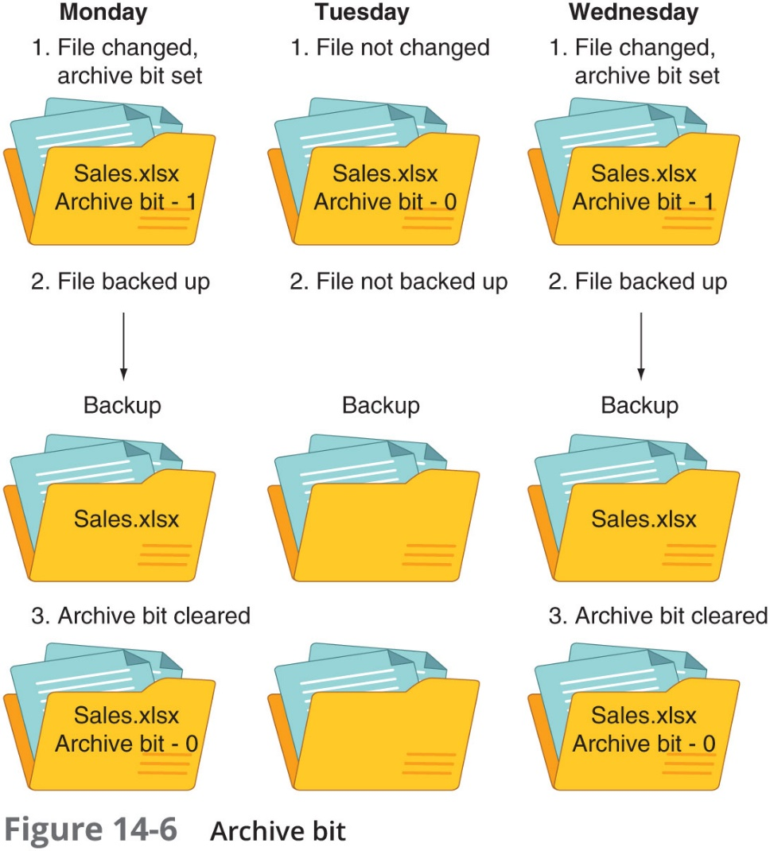
Data (4 of 5)

Slide 32
Data (5 of 5)
Types of Data Backups (continued)
A more comprehensive backup technology is known as continuous data protection (C D P)
Performs continuous backups that can be restored immediately
Maintains a historical record of all changes made to data
Creates a snapshot of the data (like a reference marker)

Slide 33
Off-Site Backups (1 of 2)
3-2-1 backup plan
Should always be three different copies of backups on at least two different types of storage media and one of the backups should be stored at a different location (off-site backup)
Most organizations store their off-site backups using an online cloud repository
These sites often use C D P to continually backup data
There are several Internet services that provide similar features to these:
Automatic continuous backup
Universal access
Delayed deletion
Online or media-based restore

Slide 34
Off-Site Backups (2 of 2)
There are legal implications of off-site backups
The primary issue involves data sovereignty
Data stored in digital format is subject to the laws of the country in which the storage facility resides
Organizations should identify a cloud services provider whose data center locations ensure that it fully complies with all applicable data sovereignty laws

Slide 35
Environmental Controls
Methods to prevent disruption through environmental controls
Fire suppression
Electromagnetic disruption protection
Proper configuration of H V A C systems

Slide 36
Fire Suppression (1 of 2)
Fire suppression includes the attempts to reduce the impact of a fire
Requirements for a fire to occur
A type of fuel or combustible material
Sufficient oxygen to sustain combustion
Enough heat to raise material to its ignition temperature
Chemical reaction: fire itself
In a server closet or room that contains computer equipment
A stationary fire suppression system is recommended

Slide 37
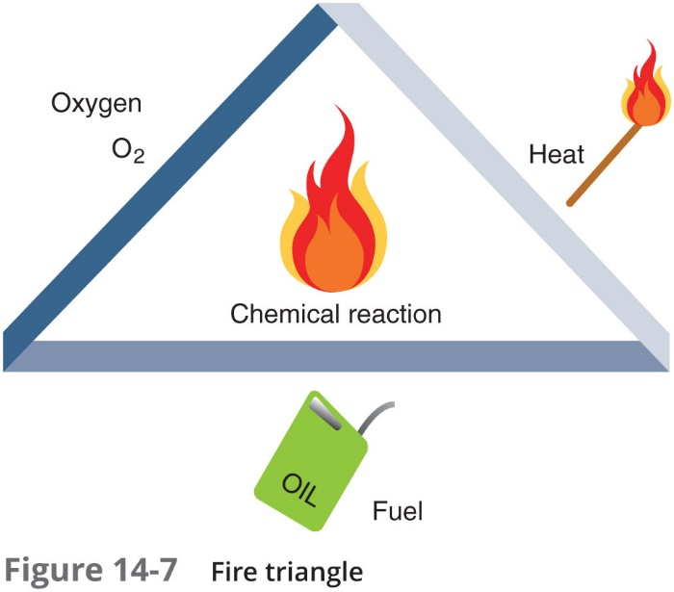
Fire Suppression (2 of 2)

Slide 38
Electromagnetic Disruption Protection (1 of 2)
Electromagnetic interference (E M I)
Caused by a short-duration burst of energy by the source called an electromagnetic pulse (E M P)
Electromagnetic compatibility (E M C)
Reducing or eliminating the unintentional generation, spread, and reception of electromagnetic energy
The goal of E M C is the correct operation of different types of equipment that function in the same electromagnetic environment
Faraday cage
Metal enclosure that prevents entry or escape of electromagnetic fields
Often used for testing in electronic labs

Slide 39
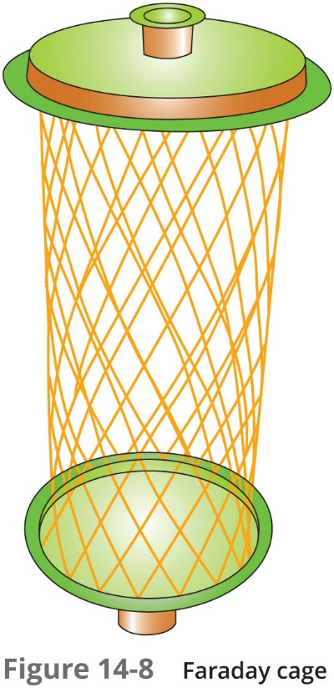
Electromagnetic Disruption Protection (2 of 2)

Slide 40
H V A C
Data centers have special cooling requirements
More cooling necessary due to large number of systems generating heat in confined area
Precise cooling needed
Heating, ventilating, and air conditioning (H V A C) systems
Maintain temperature and relative humidity at required levels
Controlling environmental factors can reduce electrostatic discharge
Hot aisle/cold aisle layout
Used to reduce heat by managing air flow
Servers lined up in alternating rows with cold air intakes facing one direction and hot air exhausts facing other direction

Slide 41
Incident Response
When an unauthorized incident occurs:
An immediate response is required
Incident response
Involves using forensics and following proper incident response procedures

Slide 42
What is Forensics?
Forensic Science
Applying science to legal questions
Analyzing evidence and can be applied to technology
Computer forensics
Uses technology to search for computer evidence of a crime
Importance of computer forensics is due to the following:
Amount of digital evidence
Increased scrutiny by the legal profession
Higher level of computer skill by criminals

Slide 43
Incident Response Plan (1 of 2)
Incident response plan (I R P)
A set of written instructions for reacting to a security incident
Incident response process – six action steps to be taken when an incident occurs:
Preparation
Identification
Containment
Eradication
Recovery
Lessons learned

Slide 44
Incident Response Plan (2 of 2)
At a minimum, an I R P should contain the following:
Documented incident definitions
Cyber-incident response teams
Reporting requirements/escalation
Exercises

Slide 45
Forensic Procedures
Five basic steps:
Secure the crime scene
Preserve the evidence
Establish a chain of custody
Examine the evidence
Enable recovery

Slide 46
Secure the Crime Scene (1 of 2)
When an illegal or unauthorized incident occurs, action must be taken immediately
Individuals in the immediate vicinity should perform damage control:
Report the incident to security or police
Confront any suspects (if situation allows)
Neutralize the suspected perpetrator from harming others
Secure physical security features
Quarantine electronic equipment
Contact the cyber-incident response team

Slide 47
Secure the Crime Scene (2 of 2)
After the response team arrives, the first job is to secure the crime scene, which includes:
Physical surroundings documented
Photographs taken before anything is touched
Computer cables labeled
Team takes custody of entire computer
Team interviews witnesses
Length of time passed since the initial incident should be noted

Slide 48
Preserve the Evidence (1 of 3)
Preservation of the evidence
Ensuring that important proof is not destroyed
Digital evidence is very fragile
Can be easily altered or destroyed
One of the first steps is for a legal hold to be issued
A notification sent from the legal team to employees instructing them not to delete electronically stored or paper documents relative to the incident
Cyber-incident response team captures volatile data
Examples: contents of RAM, current network connections, logon sessions, network traffic and logs, any open files
Order of volatility must be followed to preserve most fragile data first

Slide 49
Preserve the Evidence (2 of 3)
Location of data | Sequence to be retrieved
Register, cache, peripheral memory | First
Random access memory (RAM) | Second
Network state | Third
Running processes | Fourth

Slide 50
Preserve the Evidence (3 of 3)
Use tools that allow capturing the system image
A snapshot of the current state of the computer that contains all current settings and data
Capture the current image on the screen by taking a screenshot
Mirror image backup of the hard drive (also called a bit-stream backup)
Meets evidence standards
To guarantee accuracy, mirror image backup programs rely upon hashing algorithms as part of the validation process

Slide 51
Establish the Chain of Custody
Chain of custody
Documents that the evidence was maintained under strict control at all times
No unauthorized person was given opportunity to corrupt the evidence

Slide 52
Examine for Evidence (1 of 3)
After a computer forensics expert creates a mirror image of a system, the original system is secured and the mirror image is examined to reveal evidence
Includes searching:
Word documents, email files, spreadsheets, cache and cookies of the web browser
Hidden clues also can be exposed by examining
RAM slack, drive slack, and metadata (data about data)

Slide 53
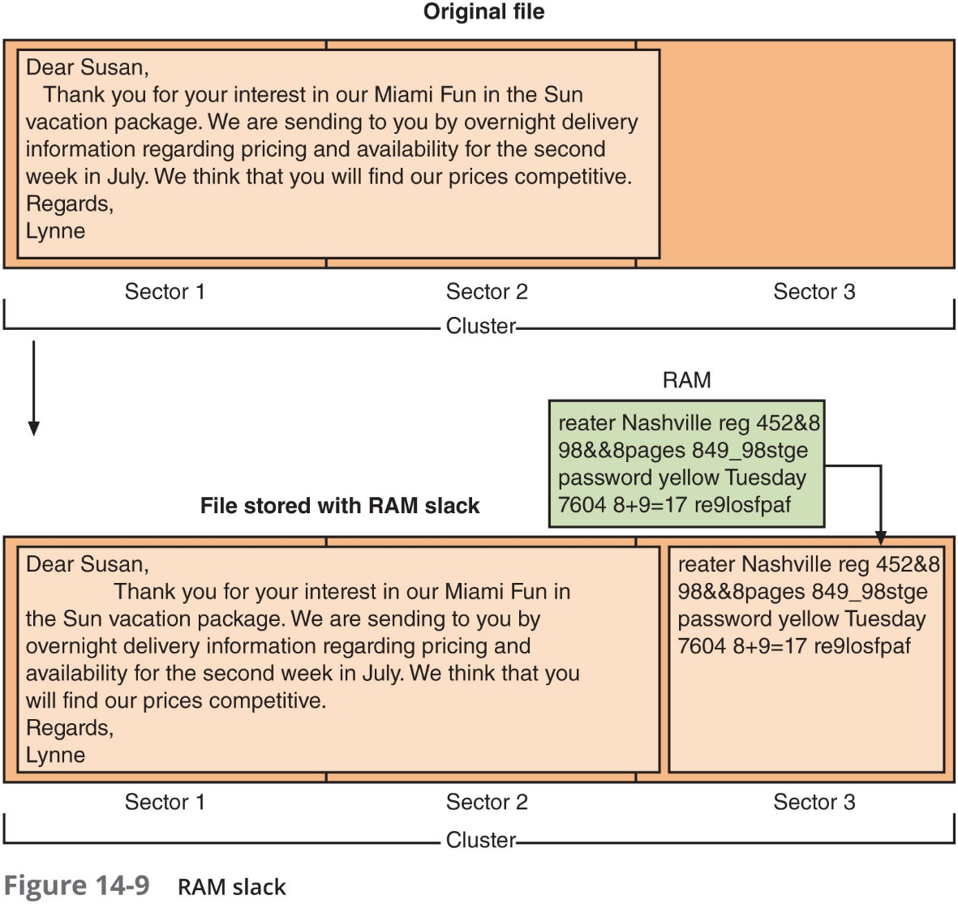
Examine for Evidence (2 of 3)

Slide 54
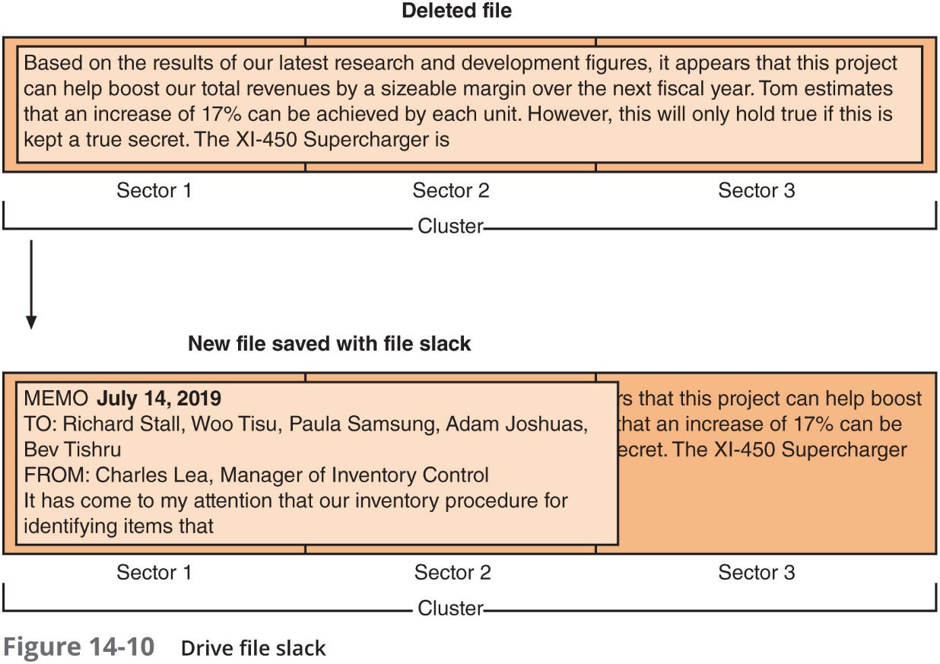
Examine for Evidence (3 of 3)

Slide 55
Enable Recovery
Strategic intelligence
The collection, processing, analysis, and dissemination of intelligence for forming policy changes
Strategic counterintelligence
Involves gaining information about the attacker’s intelligence collection capabilities
Active logging
Maintaining active logs regarding the reconnaissance activities conducted by the attacker

Slide 56
Review Questions
What is the average amount of time that it will take a device to recover from a failure that is not a terminal failure?
A. MTTR
B. MTBR
C. MTBF
D. MTTI
Which level of RAID uses disk mirroring and is considered fault-tolerant?
A. Level 1
B. Level 2
C. Level 3
D. Level 4
What is the maximum length of time that an organization can tolerate between data backups?
A. Recovery time objective (RTO)
B. Recovery service point (RSP)
C. Recovery point objective (RPO)
D. Optimal recovery timeframe (ORT)

Slide 57
Chapter Summary (1 of 3)
Business continuity is an organization’s ability to maintain its operations after a disruptive event
In I T contingency planning, an outline of procedures that are to be followed in the event of a major I T incident is developed
Disaster recovery
Focuses on restoring information technology functions
Disaster recovery plan (D R P) details restoration process
A server cluster combines two or more servers that are interconnected to appear as one
R A I D uses multiple hard disk drives for redundancy

Slide 58
Chapter Summary (2 of 3)
Network components can be duplicated to provide a redundant network
Data backup
Copying information to a different medium and storing (preferably offsite) for use in event of a disaster
Recovery point objective and recovery time objective help an organization determine backup frequency
Fire suppression systems include water, dry chemical, and clean agent systems

Slide 59
Chapter Summary (3 of 3)
A defense for shielding an electromagnetic field is a Faraday cage
The control and maintenance of H V A C systems are important for data centers
Forensic science is the application of science to questions that are of interest to the legal profession
An incident response plan (I R P) is a set of written instructions for reacting to a security incident

